Slide 1
Physics 1 – Nov 21, 2019
P3 Challenge–
  A 62 kg crate is being pulled at constant speed across a floor by a cord that makes a 30 incline to the horizontal. What is the coefficient of dynamic friction if the tension in the cord is 130 N?
Today’s Objective: Work-Kinetic Energy Theorem

Slide 2
Agenda, Assignment
IB 2.3 Work, Energy and Power
  Work
  Kinetic Energy
  Work-kinetic energy theorem
Assignment:
  Work Kinetic Energy Theorem Worksheet
Agenda
  Work
  Positive/Negative Work
  Zero work
  Kinetic Energy
  Work-kinetic energy theorem

Slide 3
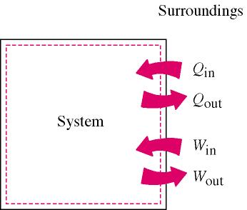
Physics Work defined
Work is the product of a force through a distance.
Positive work
  When the force and the displacement are in the same direction
  Adds to the energy of a system.
Negative work
  When the force and the displacement are in opposite directions
  Removes energy from a system
  Note: friction always does negative work.

Slide 4
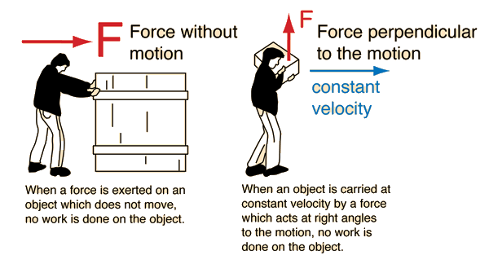
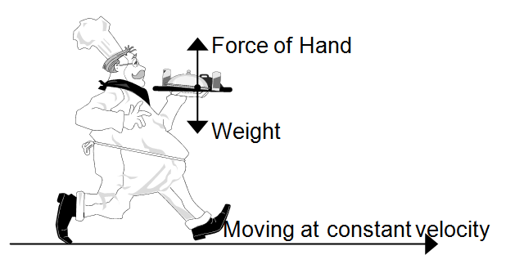
When is work NOT done?
A perpendicular force does no work.
Force applied without any change in position does no work.

Slide 5
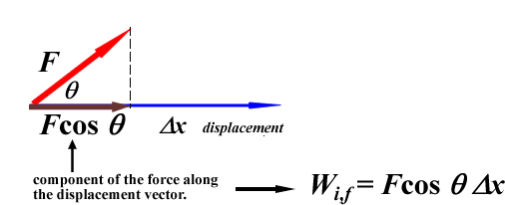
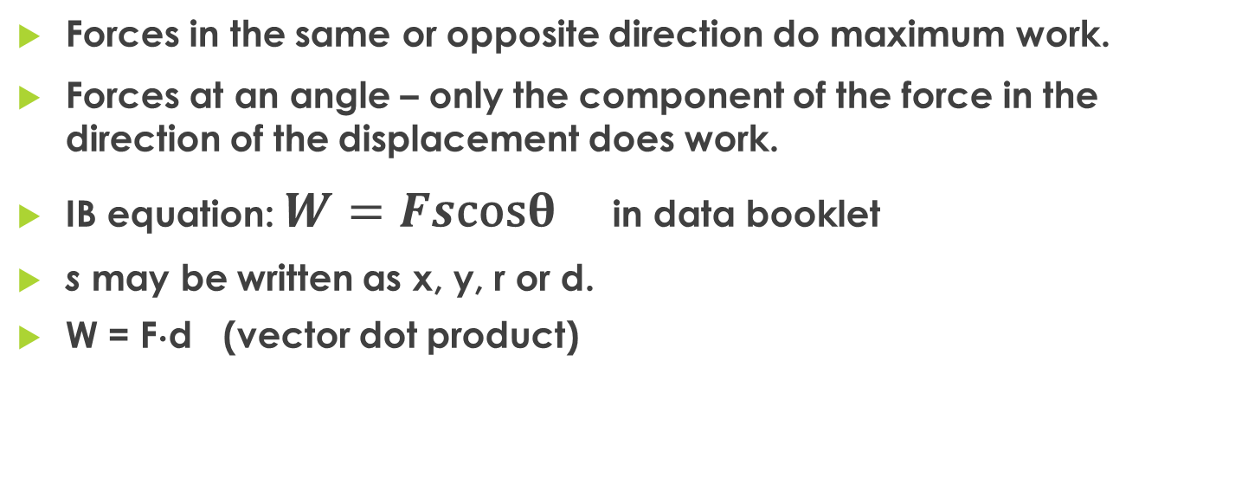
Work at an angle – general case
Forces in the same or opposite direction do maximum work.
Forces at an angle – only the component of the force in the direction of the displacement does work.
IB equation: $W=Fs\text{cos}θ$ in data booklet
s may be written as x, y, r or d.
W = Fd (vector dot product)

Slide 6
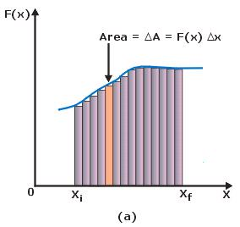
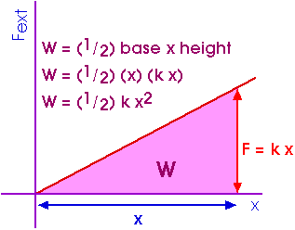
Work by a variable force
If a force is not constant over the distance, then you can plot how the force varies as a function of position.
  Still a force times a distance.
The work done by the force over a distance is represented by the area between the graph and the x-axis on this graph.
Ex: Work done by a spring force:
  W = ½ kx²

Slide 7
Practice Problems
A worker pulls a cart with a 45 N force at an angle of 25 to the horizontal over a distance of 1.2 m. What work does the worker do on the cart?
A 900N mountain climber scales a 100m cliff. How much work is done by the mountain climber?
Angela uses a force of 25 Newtons to lift her grocery bag while doing 50 Joules of work. How far did she lift the grocery bags?

Slide 8
Energy
What is energy?
  The ability to do work.
Comes in two varieties:
  E_{K} = kinetic energy E_{p} = potential energy
Types of kinetic energy: motion, light, sound, thermal energy, electrical energy (all are a type of motion)
Types of potential energy: gravitational, chemical, nuclear, spring, electrical potential (all are reversibly stored energy)

Slide 9
Kinetic Energy
Kinetic energy – energy of motion
  Anything that is moving has kinetic energy
E_{K} = ½ mv² (in data booklet)
Ex: What is the Kinetic Energy of a 150 kg object that is moving with a speed of 15 m/s?
Ex: An object has a kinetic energy of 25 J and a mass of 34 kg , how fast is the object moving?
Ex: An object moving with a speed of 35 m/s and has a kinetic energy of 1500 J, what is the mass of the object?

Slide 10
Work – K.E. Theorem
The net work done on an object is equal to the change in kinetic energy for that object.
W_{net} = K.E = ½ mv² – ½ mu²
  NOT in data booklet, need to know conceptually.
Ex: A 500. kg light-weight helicopter ascends from the ground with an acceleration of 2.00 m/s2. Over a 5.00 sec interval, what is
a. The distance the helicopter traveled?
b. The work done by the lifting force?
c. The work done by the gravitational force?
d. The net work done on the helicopter?
e. The final kinetic energy of the helicopter? (Use W= K.E )
f. The final velocity of the helicopter?
g. Verify this value using kinematics.

Slide 11
Exit Slip - Assignment
Exit Slip- How much work is done by gravity as you carry a 65 N backpack up a flight of stairs to landing 1.3 m higher than the previous floor?
What’s Due? (Pending assignments to complete.)
  Work and Kinetic Energy Worksheet
What’s Next? (How to prepare for the next day)
  Read 2.3 p78-95 about Work and Energy

